Slide 1
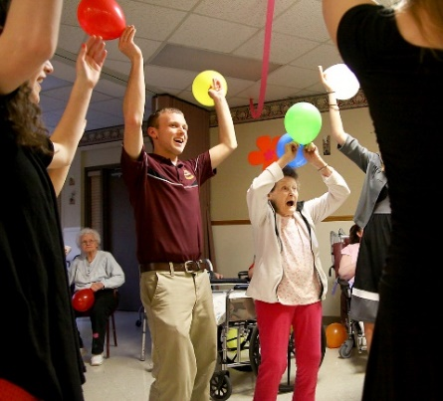


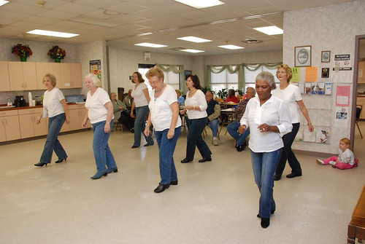
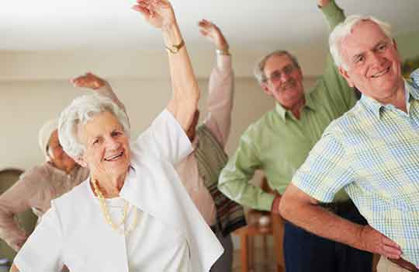

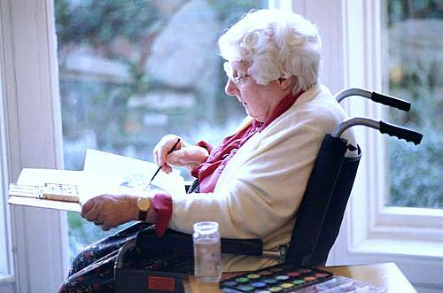
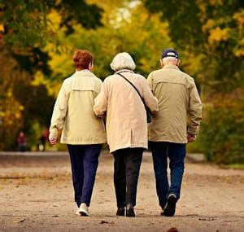


BCHA
Fit @ 70

Slide 2



Background
Staying physically and mentally active as you get older can help you stay healthier for longer and remain independent. Many adults over 65 spend an average of 10 hours or more a day sitting or lying down and this inactivity risks higher likelihood of falls, obesity, heart disease and death. There is strong evidence that keeping active reduces the risk of heart disease, stroke, type 2 diabetes, some cancers, depression and dementia.
Keeping mentally active and being connected to people and services online can help combat loneliness and isolation and help to keep people participating in society. For some people accessing exercise sessions online can provide a great alternative to group sessions and allows participation from the comfort of home.
Within retirement living schemes, offering programmes of physical activity and digital inclusion support to build skills and confidence to go online and access services and connect with others is a way to improve physical and mental health outcomes for residents. Tackling the health inequalities that pandemic has reinforced and exacerbated will help reach some of the residents in our communities with the most to gain but who may at the moment be the least able to take part.

Slide 3

Project Information
BCHA is a small Bedford based Housing Association which provides accommodation and support for older people. This includes Extra Care Housing, Sheltered Housing and a Care Home.
Monies have been used to pay for external providers to deliver exercise classes at Charter House our care home and in our older peoples housing.
Older residents wanted to attend exercise classes in their schemes.

Slide 4
Project Delivery
Activity 1
Activity 2
Activity 3
Activities Schedule for over 70’s
Exercise Classes have taken place as listed below
Charter House | Oak Way | Bedesman | Maydenbury
12/04/2023 | 10/04/2023 | 06/04/2023 | 07/04/2023
19/04/2023 | 17/04/2023 | 13/04/2023 | 14/04/2023
26/04/2023 | 24/04/2023 | 20/04/2023 | 21/04/2023
03/05/2023 | 01/05/2023 | 27/04/2023 | 28/04/2023
10/05/2023 | 08/05/2023 | 04/05/2023 | 05/05/2023
17/05/2023 | 15/05/2023 | 11/05/2023 | 12/05/2023
24/05/2023 | 22/05/2023 | 18/05/2023 | 19/05/2023
31/05/2023 | 29/05/2023 | 25/05/2023 | 26/05/2023
07/06/2023 | 05/06/2023 | 01/06/2023 | 02/06/2023
14/06/2023 | 12/06/2023 | 08/06/2023 | 09/06/2023
21/06/2023 | 19/06/2023 | 15/06/2023 | 16/06/2023
28/06/2023 | 26/06/2023 | 22/06/2023 | 23/06/2023
05/07/2023 | 03/07/2023 | 29/06/2023 | 30/06/2023

Slide 5

Participation Information
Numbers of participants
Charter House | Participants | Oak Way | Participants | Bedesman | Participants | Maydenbury | Participants
12/04/2023 | 11 | 10/04/2023 | 4 | 06/04/2023 | 6 | 07/04/2023 | 8
19/04/2023 | 14 | 17/04/2023 | 3 | 13/04/2023 | 6 | 14/04/2023 | 8
26/04/2023 | 16 | 24/04/2023 | 4 | 20/04/2023 | 0 | 21/04/2023 | 6
03/05/2023 | 11 | 01/05/2023 | 4 | 27/04/2023 | 5 | 28/04/2023 | 9
10/05/2023 | 12 | 08/05/2023 | 3 | 04/05/2023 | 5 | 05/05/2023 | 8
17/05/2023 | 10 | 15/05/2023 | 5 | 11/05/2023 | 5 | 12/05/2023 | 7
24/05/2023 | 11 | 22/05/2023 | 5 | 18/05/2023 | 5 | 19/05/2023 | 9
31/05/2023 | 12 | 29/05/2023 | 4 | 25/05/2023 | 5 | 26/05/2023 | 9
07/06/2023 | 14 | 05/06/2023 | 2 | 01/06/2023 | 5 | 02/06/2023 | 8
14/06/2023 | 12 | 12/06/2023 | 3 | 08/06/2023 | 5 | 09/06/2023 | 8
21/06/2023 | 10 | 19/06/2023 | 3 | 15/06/2023 | 5 | 16/06/2023 | 8
28/06/2023 | 12 | 26/06/2023 | 3 | 22/06/2023 | 5 | 23/06/2023 | 8
05/07/2023 | 10 | 03/07/2023 | 1 | 29/06/2023 | 5 | 30/06/2023 | 8

Slide 6
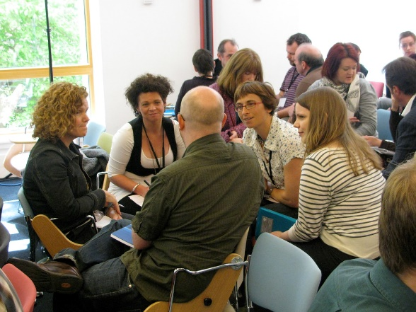
Resident Feedback
That was a good work out!
I like to see Nick
Thank you. The sessions really helps me
I really enjoy the exercises
“Bingo wings” have had a good work out with the new instructor
Glad I came along

Slide 7
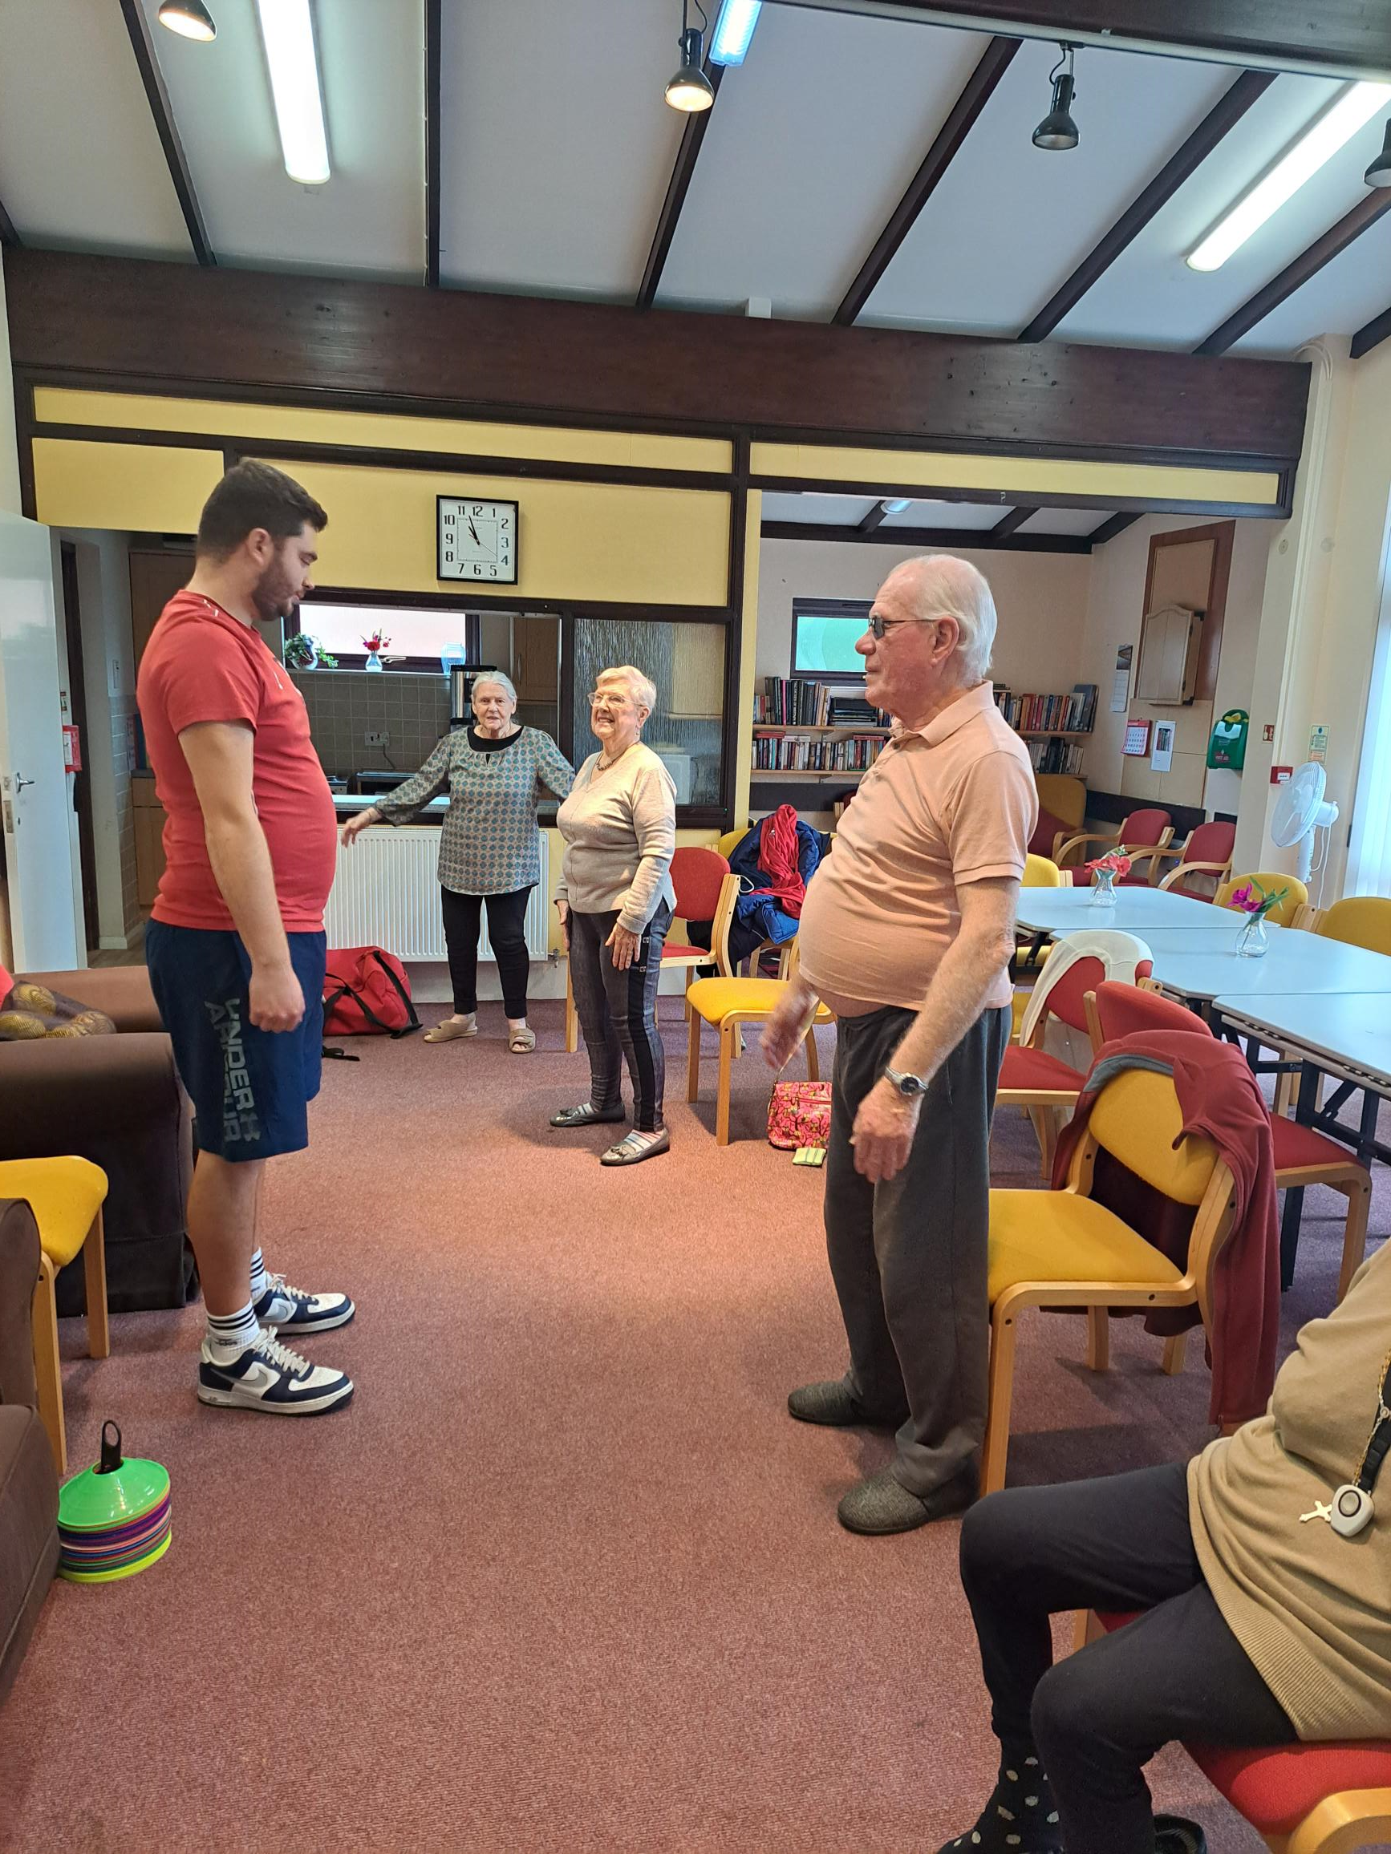
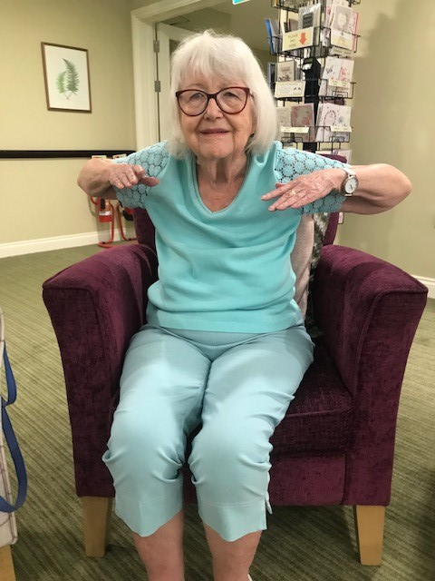
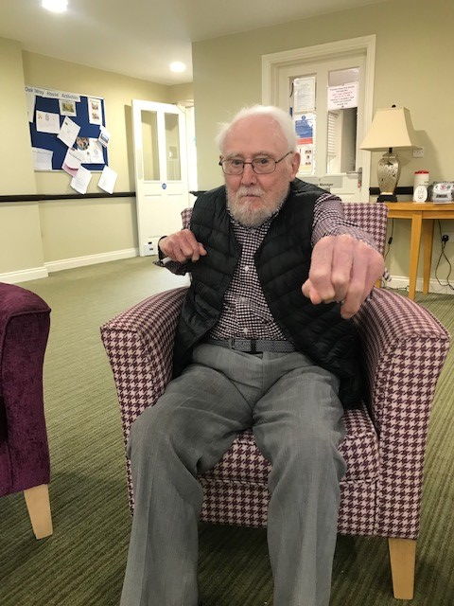
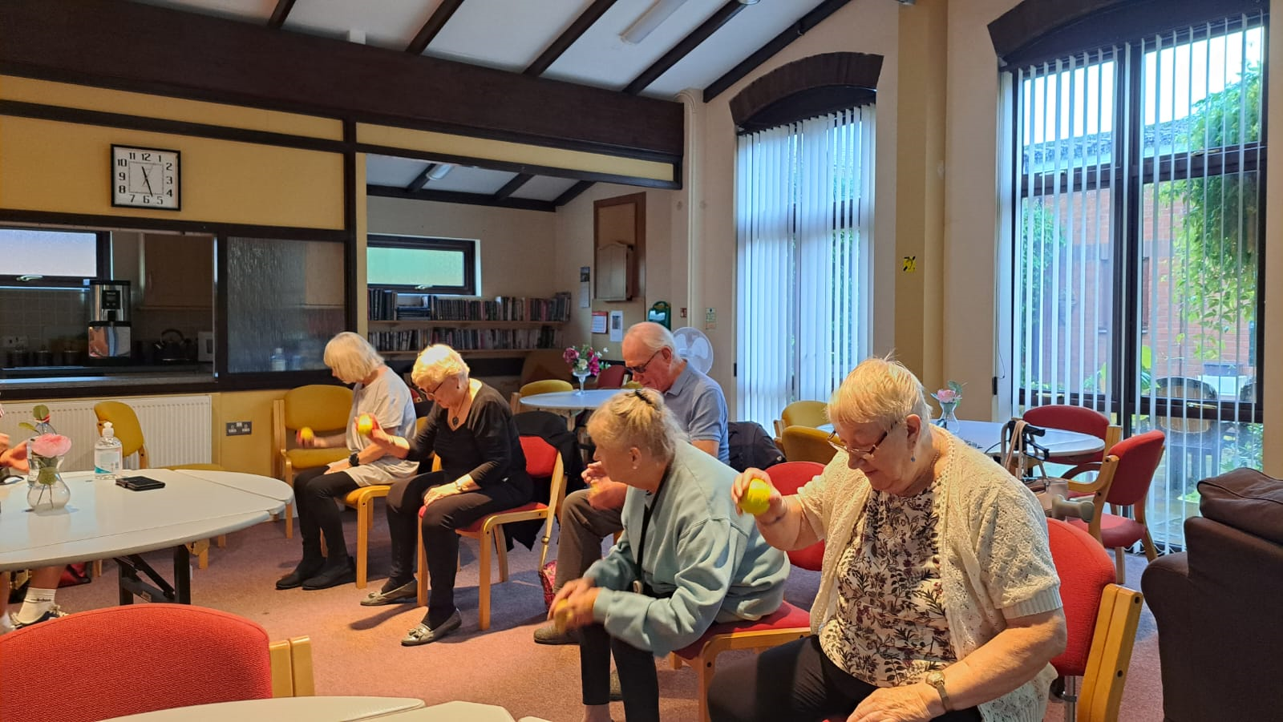
Photos

Slide 8
Financial Information
Charter House | Cost | Oak Way | Cost | Bedesman | Cost | Maydenbury | Cost
12/04/2023 | £18.00 | 10/04/2023 | £18.00 | 06/04/2023 | £18.00 | 07/04/2023 | £18.00
19/04/2023 | £18.00 | 17/04/2023 | £18.00 | 13/04/2023 | £18.00 | 14/04/2023 | £18.00
26/04/2023 | £18.00 | 24/04/2023 | £18.00 | 20/04/2023 | £0.00 | 21/04/2023 | £18.00
03/05/2023 | £18.00 | 01/05/2023 | £18.00 | 27/04/2023 | £18.00 | 28/04/2023 | £18.00
10/05/2023 | £18.00 | 08/05/2023 | £18.00 | 04/05/2023 | £18.00 | 05/05/2023 | £18.00
17/05/2023 | £18.00 | 15/05/2023 | £18.00 | 11/05/2023 | £18.00 | 12/05/2023 | £18.00
24/05/2023 | £18.00 | 22/05/2023 | £18.00 | 18/05/2023 | £18.00 | 19/05/2023 | £18.00
31/05/2023 | £18.00 | 29/05/2023 | £18.00 | 25/05/2023 | £18.00 | 26/05/2023 | £18.00
07/06/2023 | £18.00 | 05/06/2023 | £18.00 | 01/06/2023 | £18.00 | 02/06/2023 | £18.00
14/06/2023 | £18.00 | 12/06/2023 | £18.00 | 08/06/2023 | £18.00 | 09/06/2023 | £18.00
21/06/2023 | £18.00 | 19/06/2023 | £18.00 | 15/06/2023 | £18.00 | 16/06/2023 | £18.00
28/06/2023 | £18.00 | 26/06/2023 | £18.00 | 22/06/2023 | £18.00 | 23/06/2023 | £18.00
05/07/2023 | £18.00 | 03/07/2023 | £18.00 | 29/06/2023 | £18.00 | 30/06/2023 | £18.00
 | £ 234.00 |  | £ 234.00 |  | £ 216.00 |  | £ 234.00 | £ 918.00
Income Received | £ 3,894.00
Quarter 1 | £ 918.00
Quarter 2 | £ 918.00
Quarter 3
Quarter 4
Total Expenditure | £ 1,836.00
Balance | £ 2,058.00

Slide 9

Project Review & Planning for the Future
We encourage all new residents to attend the sessions
Successes to date – running an exercise class – lots of fun had by residents – relationship building – good for residents wellbeing
Awaiting results of the residents survey
Opportunities for future project work we have trained staff in delivering exercise classes in house
Joining the exercise class has encouraged participation in other communal activities which helps residents feel part of a community

